Slide 1

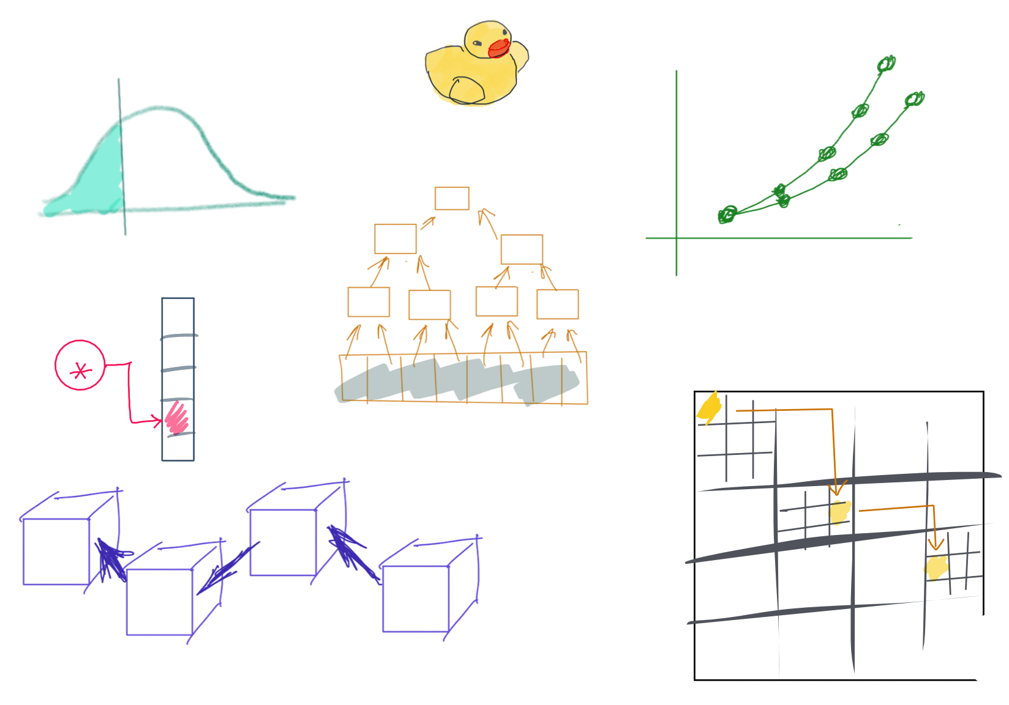

Slide 2
CSS342 Data Structures, Algorithms, and Discrete Mathematics (I)

Slide 3

2nd Week Task Items
Homework Submission Procedures (Wed)
Create a Pull Request GitHub
Homework 1 Review (a separate video to be release Tuesday noon)
C++ Basics (Wed)
Memory, e.g. pointer, reference
More C++ (Fri)
Class type basics (constructor/destructor, copy constructor, operator overload)
Quiz C++ (Fri)
About C++ pointer, reference
Test Driven Development (Fri)
Homework 2 to be assigned on Fri

Slide 4
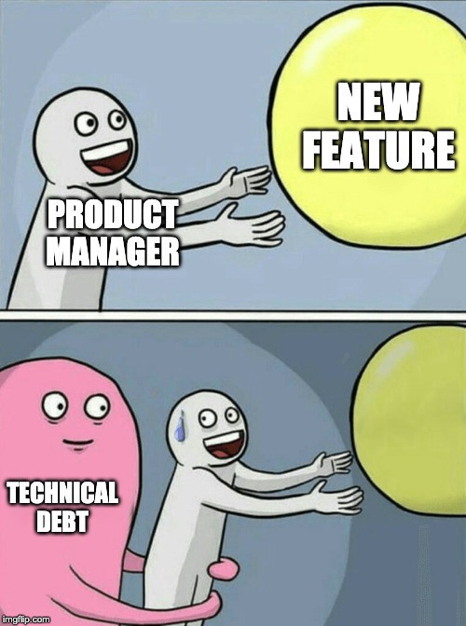
Technical Debt Log
Technical Debt: Topics that you should’ve understood but not yet.
Keep a journal throughout the semester (somewhere only you can see, e.g. a private GitHub repo)
Date | Debt Topic | Plan To Fix | Status
Bring this to 1:1 discussion
Weekly log throughout semester 10pt → extra credit on Final

Slide 5
Study Priority
Lecture PPT
Homework Code
Your code
Given code, e.g. tests
C++
Textbook
In-lecture demo
Code-along
Example code
Your technical debt items

Slide 6
Ask The Right Question
“My code doesn’t work.”
Which test case is failing?
What’s the specific error/failure?
What have your tried?
Breakpoint?
stackoverflow.com?
Google?
“my code is failed with test case …. The error is … I have done … and … but those didn’t help.”

Slide 7
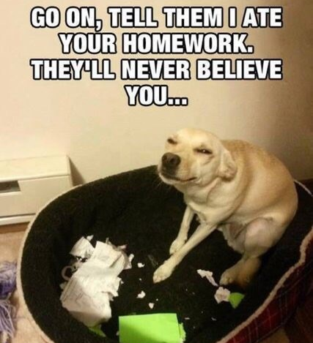
Source Control
“My laptop crashed last night, and my homework is gone”
How do you safely store your code and track changes?

Slide 8
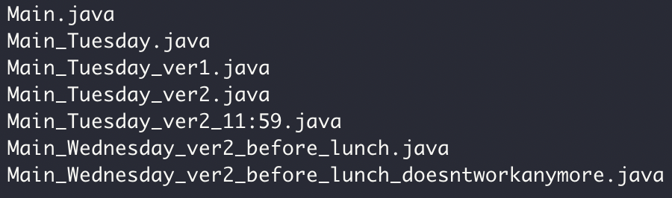

Source Control

Slide 9
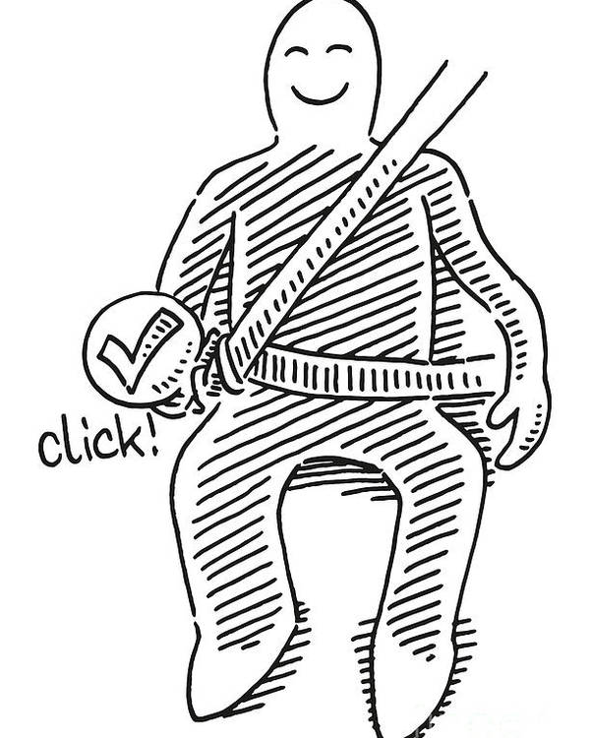
Why Git and GitHub
Widely used in industry and open source projects
Easy to track progress (commits)
Easy to track features (branch)
Easy to collaborate with others (GitHub)
Example: https://github.com/futurewei-cloud/chogori-platform

Slide 10


Source Control
Code version 1
Code version 2
Code version 3
“commits”
Code version 1
Code version 2
Code version 3
Code
……
Your computer
Monday
Tuesday
Wednesday
Thursday

Slide 11



Git/GitHub Terms
Repository, or “Repo”
Collection files from a project
Commit
A snapshot of the repo at the certain time
Branch
A line of development, consisting of a series of commits

Slide 12
Source Control: Branch
Commit 1
Commit 2
Commit 3
Commit 6
Merge, Commit 7
The Main branch
another branch
Commit 4
Commit 5

Slide 13


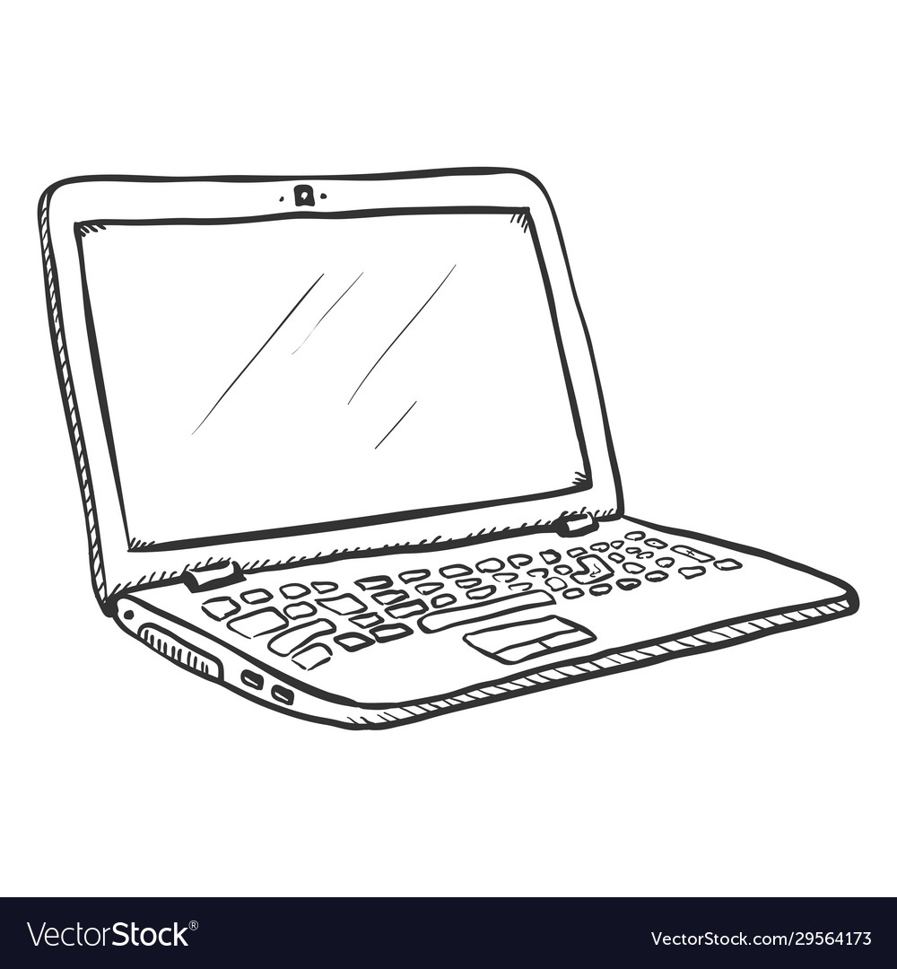
Push
Pull

Slide 14
Pull
Push

Slide 15
Homework repo
Exact Mirror
Homework repo

Slide 16
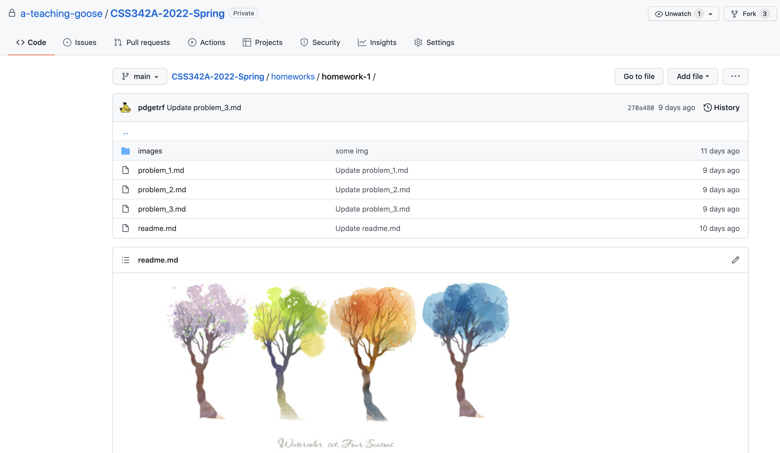
Homework 1 Review
https://github.com/a-teaching-goose/CSS342A-2022-Spring/tree/main/homeworks/homework-1
Detailed review video: https://youtu.be/7pjg2hNfovs

Slide 17

Binary Search
Target: 14
1
3
5
7
9
10
12
12
14
14
18

Slide 18
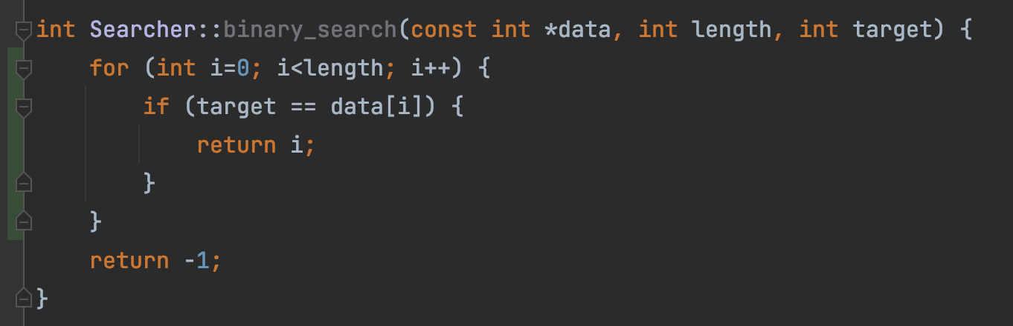
This is linear search, not binary search
“But test passed!”
Test passed
➔ ?
Code is correct
Test failed
➔ ?
Code is wrong

Slide 19
Bubble Sort
9
1
8
7
3
1
9
8
7
3
Round 1
1
8
9
7
3
1
8
7
9
3
1
8
7
3
9

Slide 20
1
8
7
3
9
1
8
7
3
9
Round 2
1
7
8
3
9
1
7
3
8
9

Slide 21
1
7
3
8
9
Round 3
1
7
3
8
9
1
3
7
8
9

Slide 22
1
3
7
8
9
Round 4
1
3
7
8
9

Slide 23
1
3
7
8
9
Round 5
1
3
7
8
9

Slide 24

Homework Submission Demo

Slide 25
Submission Task List
Fork the code repo
Enable Action in your repo (can be done any time)
Clone your repo to CLion
Create a new branch (any name you want), and switch to it for work
Write code, commit frequently. Push occasionally.
Create a Pull Request (from your ‘work’ branch to your ‘main’ branch)
Verify all tests pass. Fix issue if anything failed. Push and it runs again.
Submit Pull Request url in Canvas

Slide 26
Demo video
The Submission Process
Instructor repo, main branch
Fork (”meaning copy”)
your repo, main branch
Pull Request
This url is what you submit
your repo, Work branch
more commits

Slide 27
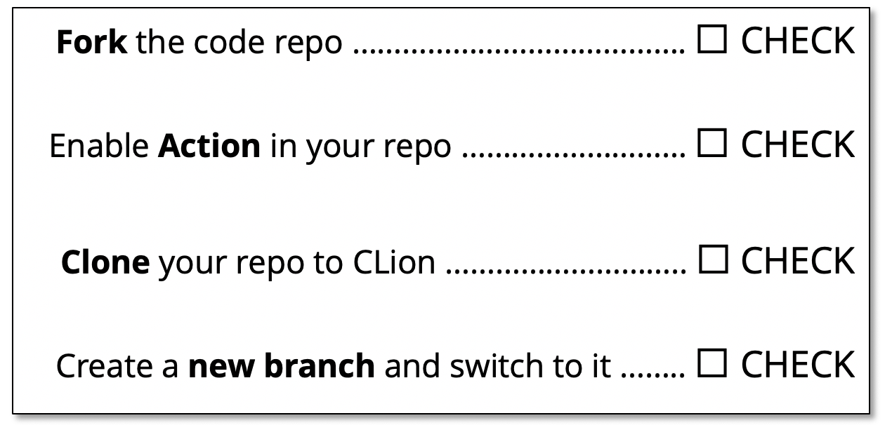
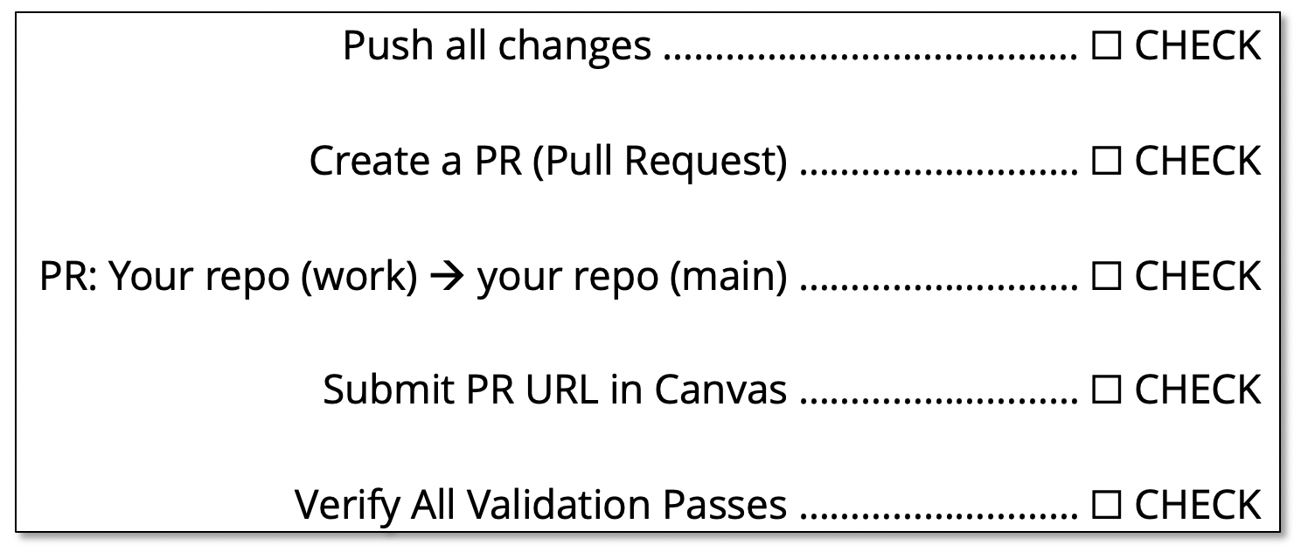
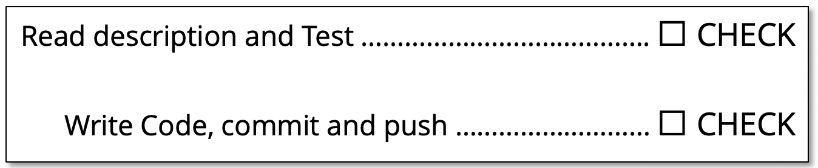
Submission Checklist
https://github.com/a-teaching-goose/CSS342A-2022-Spring/blob/main/homeworks/submission_checklist.md
1
Before Coding Checklist
3
Submission Checklist
2
Coding Checklist

Slide 28
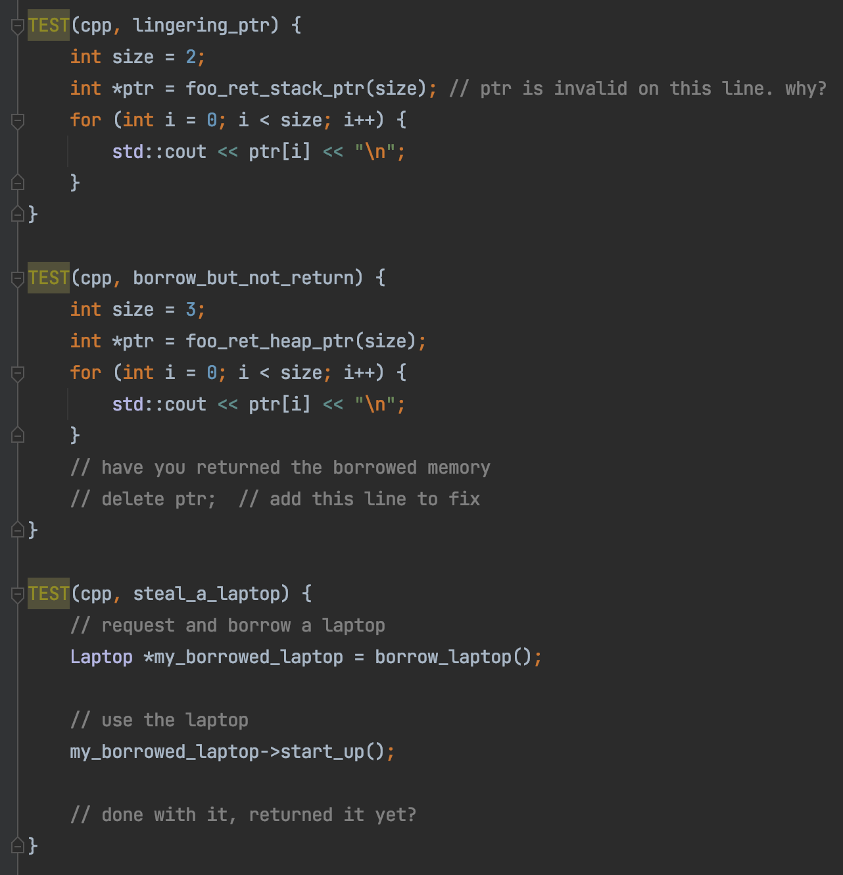
C++ Memory

Slide 29

Friday Topics
C++ Class
Constructor, Destructor
Copy constructor
Operator overload
OOP (Class)
Testing

Slide 30
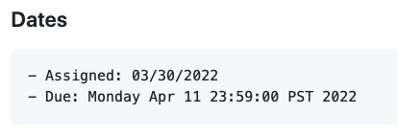
Info
Study Group
Weekend, Sunday, 4pm – 6pm, UW1/Online
Homework 1 Due
Link here

Slide 31
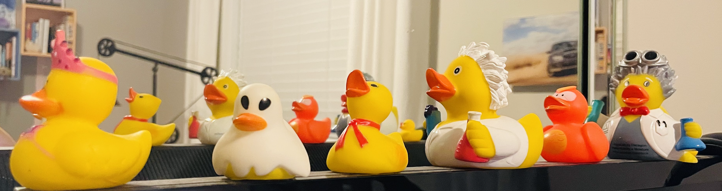

Class vs Object
Class：
A “kind” of thing
Object：
Concrete Object
“Rubber Duck”

Slide 32
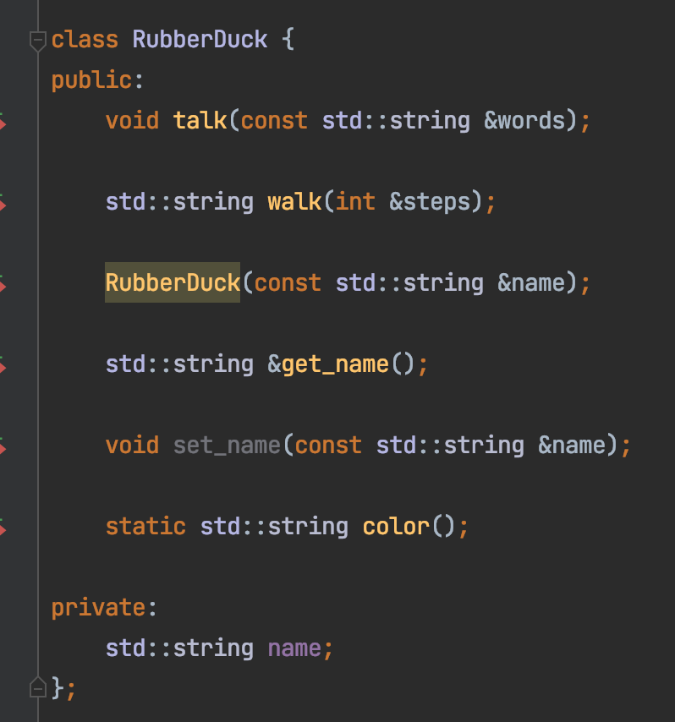
Class
Member Variables:
Name
Member Methods:
walk
talk

Slide 33
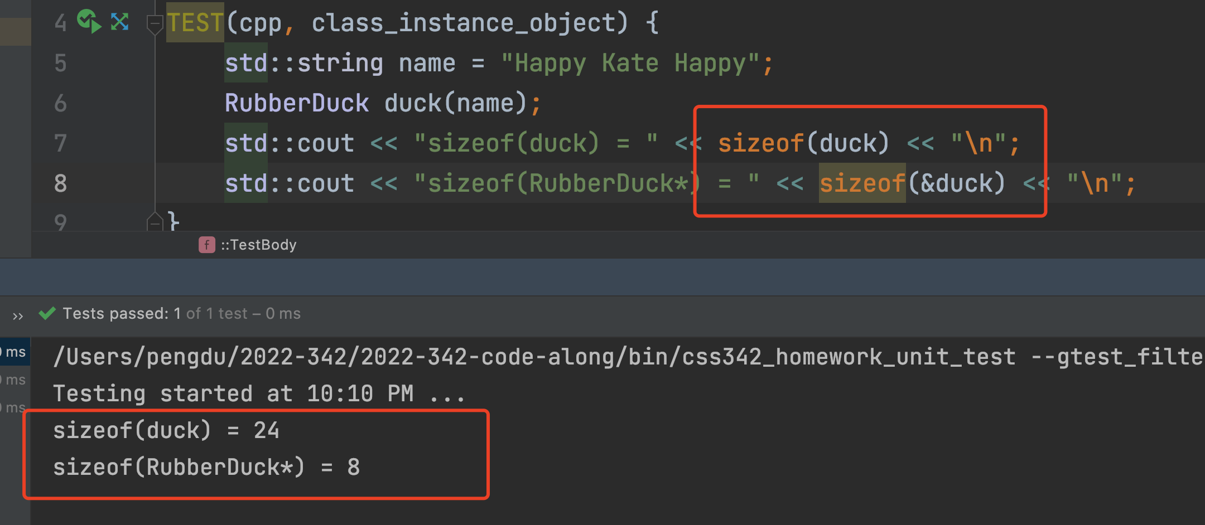
Class Instance
Hexadecimal Address
0x0
1 byte (8 bits)
0x8
0x10
0x18
… …
duck
sizeof(int*)
24 bytes

Slide 34

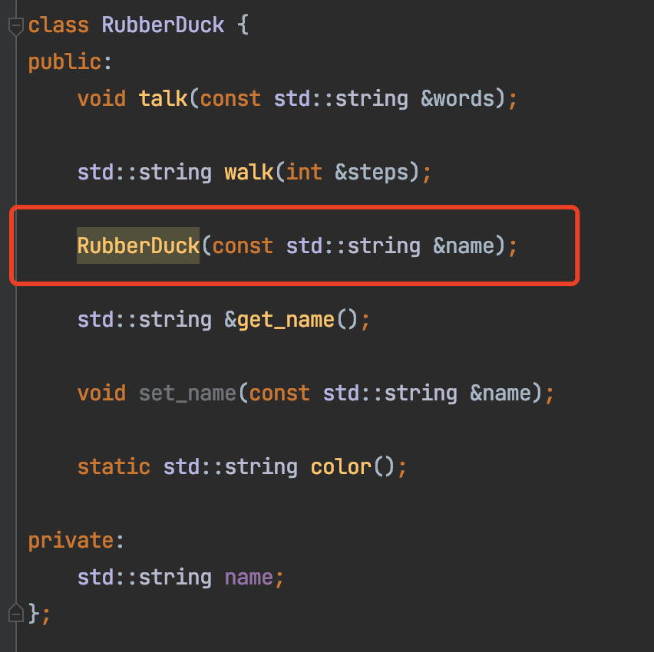

Constructor
Code here

Slide 35
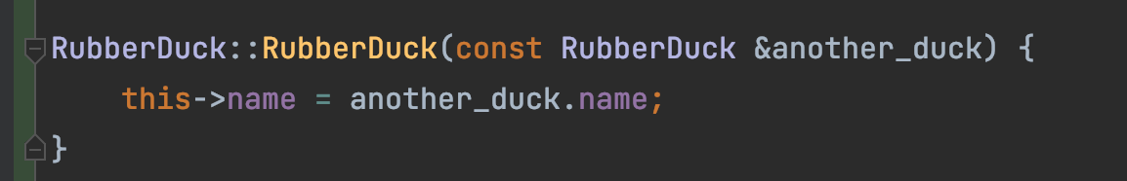
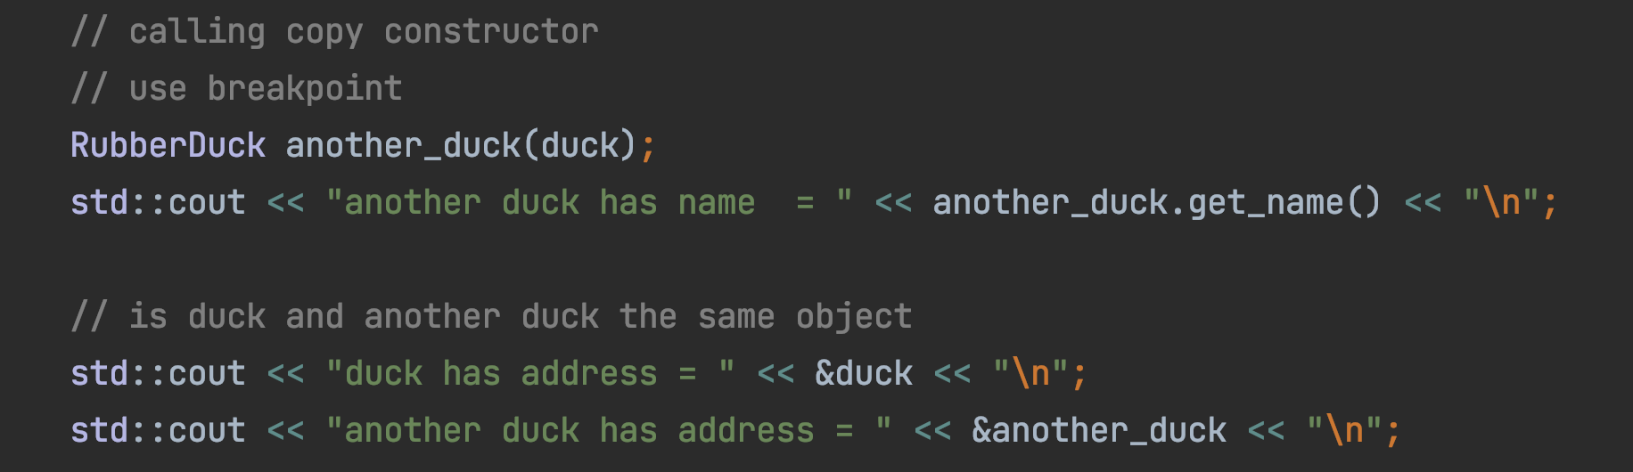
Copy Constructor
copy

Slide 36
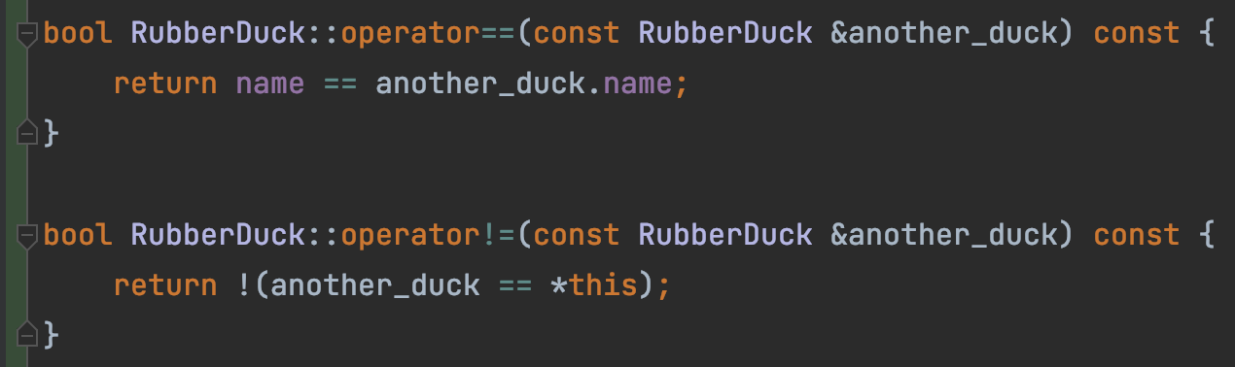
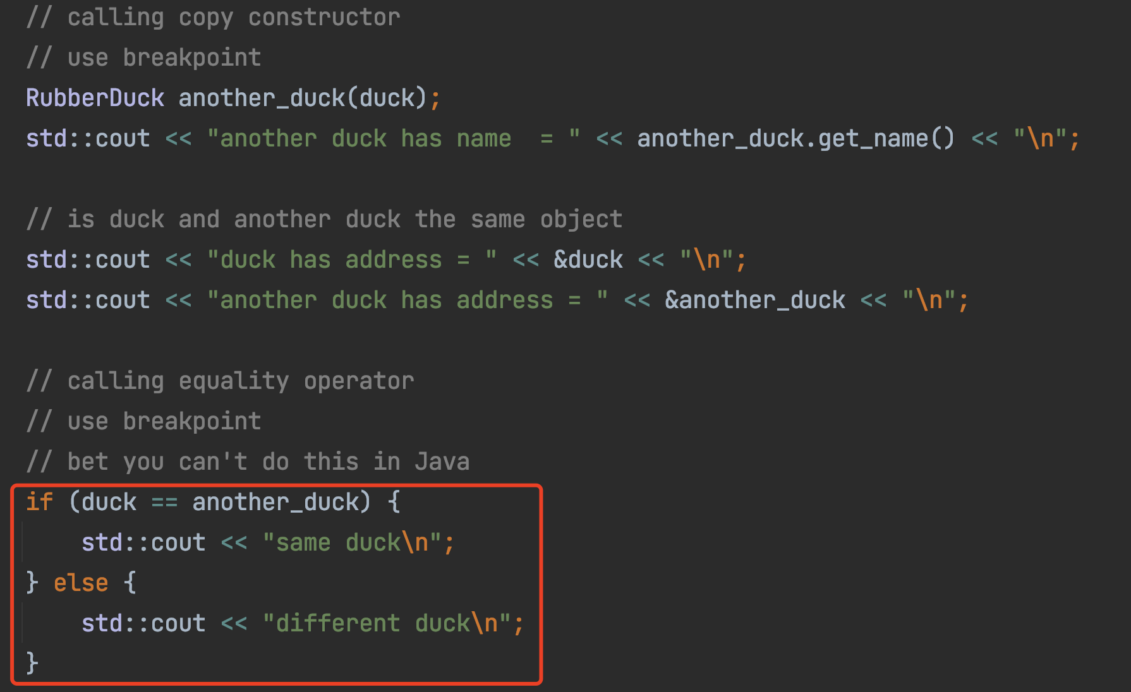
Operator Overload (==, !=)

Slide 37
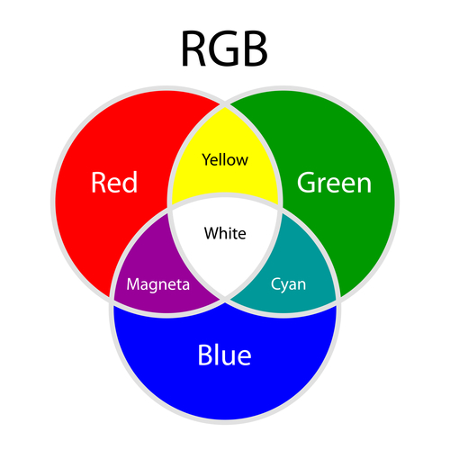
Operator Overload (+)
Red + Green = Yellow
Red + Blue = Magenta
Green + Blue = Cyan

Slide 38
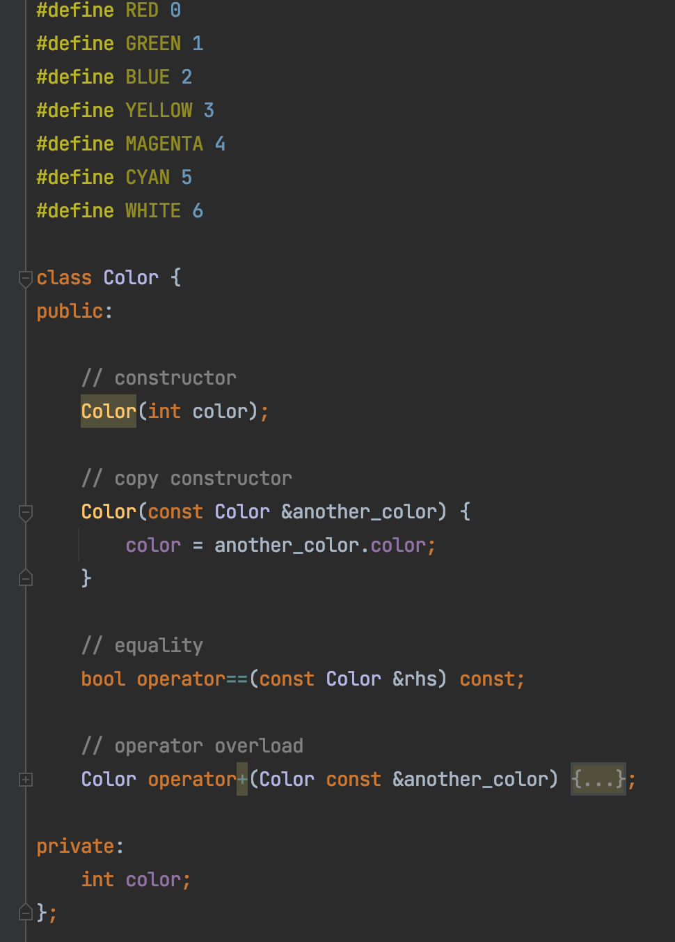
Operator Overload (+)

Slide 39


Homework 1, Problem 3
A
B
C
Influencer 1
Followers
X
Y
B
Influencer 3
B
C
D
Followers
Influencer 2
Followers

Slide 40
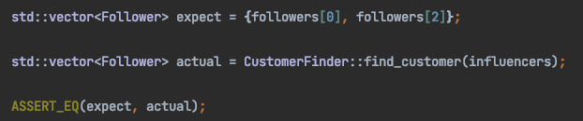
Homework 1, Problem 3
expect: What SHOULD BE the correct value
actual: What SHOULD BE the correct value

Slide 41
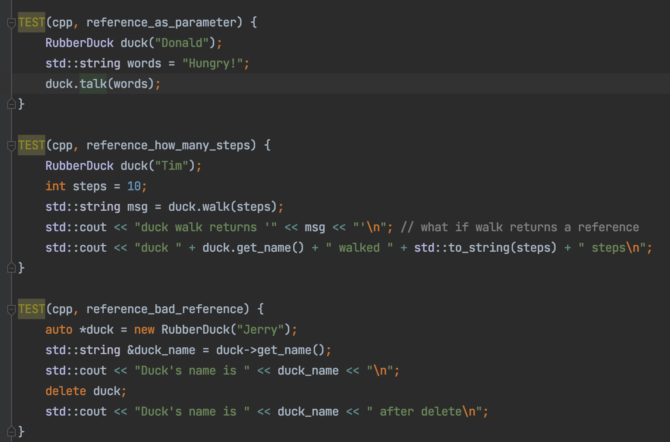
C++ Reference

Slide 42

AWS Account
Use for
Debugging memory leak on Linux
Apply here https://aws.amazon.com/
Free! (Even though it asks you to put in a credit card)
Will use it next Wednesday in lecture

Slide 43
Submission Checklist
Fork the code repo …………………………………. ☐ CHECK
Enable Action in your repo ……………………… ☐ CHECK
Clone your repo to CLion ……………………….. ☐ CHECK
Create a new branch and switch to it …….. ☐ CHECK

Slide 44
Submission Checklist
Read description and Test …………………………………. ☐ CHECK
Write Code, commit and push ……………………… ☐ CHECK
Push all changes …………………………………. ☐ CHECK
Create a PR (Pull Request) ……………………… ☐ CHECK
PR: Your repo (work) → your repo (main) ……………………… ☐ CHECK
Submit PR URL in Canvas ……………………… ☐ CHECK
Verify All Validation Passes ……………………… ☐ CHECK

